Slide 1


SMART ATTENDANCE
SYSTEM USING FACE RECOGNITION
2026
PRESENTED BY -
V.SHIVA -2520090092
V.SATHVIK-2520090097
PRANAV.R-2520090109

Slide 2

THE Smart Attendance System Using Face Recognition is a web-based system that automatically identifies students using face recognition and records their attendance in MongoDB.
MAIN FEATURES:
  STUDENT REGISTRATION
  FACE RECOGNITION
  AUTOMATIC ATTENDANCE MARKING
  ADMIN DASHBOARD
  MONGODB DATABASE STORAGE
Project Overview

Slide 3

Front-End Development
  HTML: CREATES THE WEB PAGES AND FORMS.
  CSS: DESIGNS THE LAYOUT AND USER INTERFACE.
  JAVASCRIPT: HANDLES FACE RECOGNITION, CAMERA ACCESS, AND ATTENDANCE ACTIONS.
  FACE-API.JS: PERFORMS FACE DETECTION AND RECOGNITION USING THE WEBCAM

Slide 4
Frontend Modules / Features
  ADMIN LOGIN MODULE
  Student Registration Module
  Face Capture Module
  Face Recognition Module
  Attendance Marking Module
  Attendance Dashboard Module

Slide 5

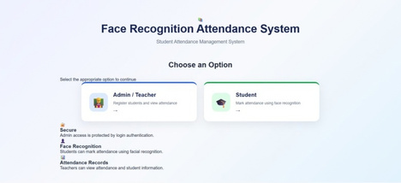
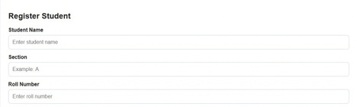
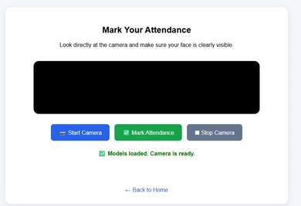
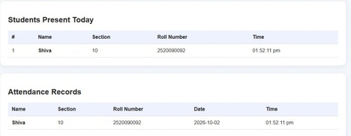

login / register
Frontend screen shots
Dashboard
Face recognition

Slide 6

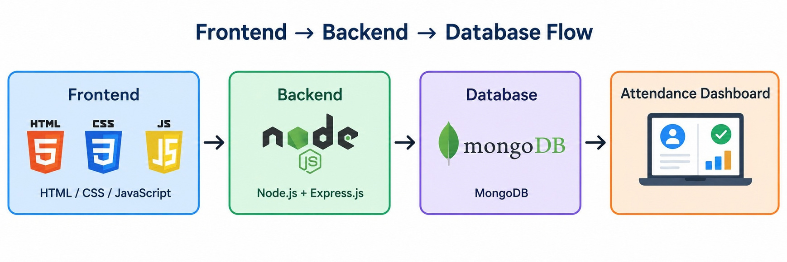

Frontend → Backend → Database Flow
  FRONTEND: HTML, CSS, AND JAVASCRIPT CREATE THE USER INTERFACE.
  Backend: Node.js and Express.js process requests.
  Database: MongoDB stores student and attendance data.
  Face Recognition: Identifies registered students through the webcam.
  Dashboard: Displays attendance information to the admin.

Slide 7

Database Design
  DATABASE: MONGODB
  Students Collection: Student ID, Name, Section, Roll Number, Face Descriptor
  Attendance Collection: Attendance ID, Student ID, Date, Time, Status
  Relationship: One student can have multiple attendance records.

Slide 8


ER Diagram /Database Schema
STUDENTS COLLECTION :
  studentId
  name
  section
  rollNumber
  faceDescriptor
ATTENDANCE COLLECTION :
  ATTENDANCEID
  STUDENTID
  DATE
  TIME
  STATUS

Slide 9
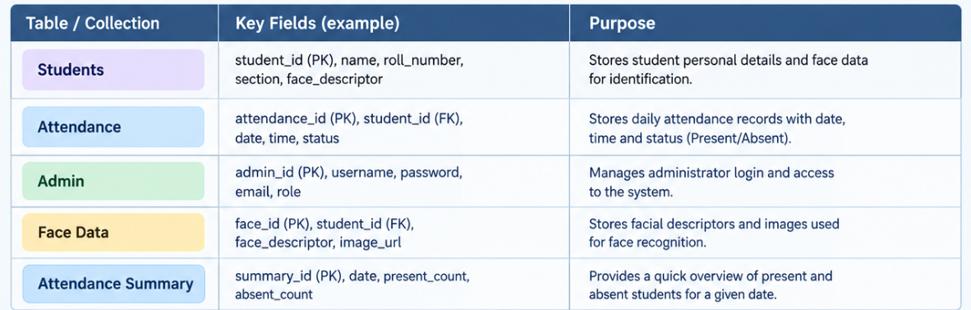
Tables and Their Purpose

Slide 10
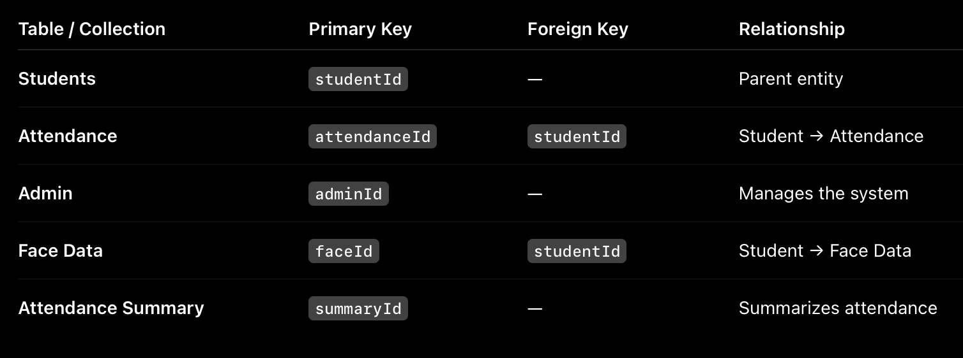
Keys and Relationships

Slide 11
Database Operations
  NSERT: ADD NEW STUDENT AND ATTENDANCE RECORDS.
  Read: Retrieve student and attendance details.
  Update: Modify student information when required.
  Delete: Remove student or attendance records.
  Search: Find students using roll number or student ID.
  Count: Calculate total students and present students.
  Store: Save face descriptors and attendance data in MongoDB.

Slide 12
INSERT INTO STUDENTS VALUES (1, 'RAHUL', 'A', '101');
SELECT * FROM Students;
SELECT * FROM Attendance;
UPDATE Students SET section='B' WHERE studentId=1;
DELETE FROM Students WHERE studentId=1;
Sample SQL Queries

Slide 13
Current Implementation / Progress
  Frontend: HTML, CSS, and JavaScript completed.
  Backend: Node.js and Express.js implemented.
  Face Recognition: Webcam-based face recognition implemented.
  Database: MongoDB integration completed.
  Attendance: Automatic attendance marking implemented.
  Dashboard: Student and attendance details displayed.

Slide 14
Conclusion and Next Steps
CONCLUSION:
  THE SYSTEM AUTOMATES ATTENDANCE USING FACE RECOGNITION.
  STUDENT AND ATTENDANCE DATA ARE STORED IN MONGODB.
  IT REDUCES MANUAL WORK AND SAVES TIME.
NEXT STEPS:
  IMPROVE FACE RECOGNITION ACCURACY.
  ADD ATTENDANCE REPORT GENERATION.
  IMPROVE THE DASHBOARD AND USER INTERFACE.
  ADD MOBILE APPLICATION SUPPORT.

Slide 15

Thank You
2026

